Slide 1

古代文獻

Slide 2
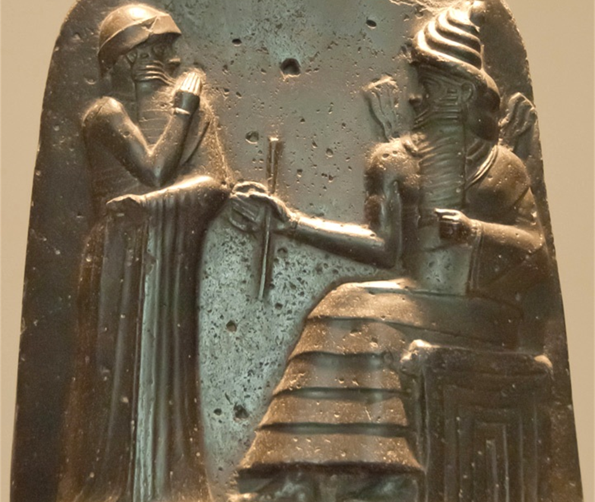
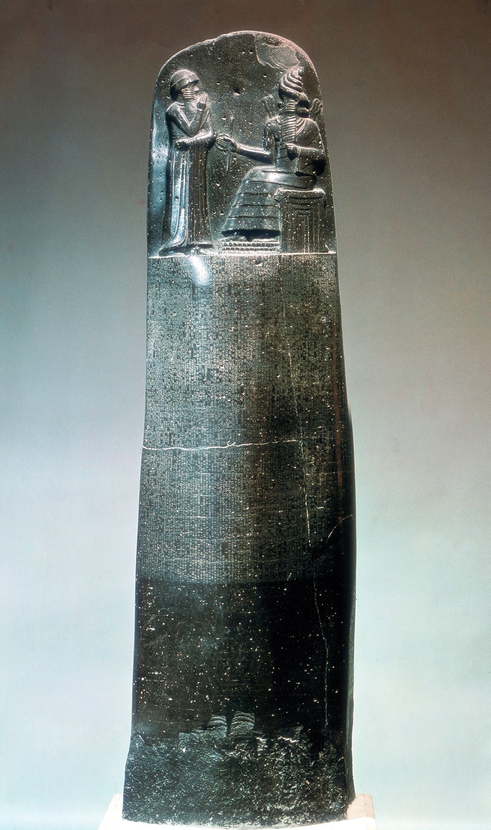
Law Code of Hammurabi
(1791-1750 B.C.)

Slide 3
196. If a man put out the eye of another man, his eye shall be put out. [ An eye for an eye ]
198. If he put out the eye of a freed man, or break the bone of a freed man, he shall pay one gold mina.
199. If he put out the eye of a man's slave, or break the bone of a man's slave, he shall pay one-half of its value.
200. If a man knock out the teeth of his equal, his teeth shall be knocked out. [ A tooth for a tooth ]
201. If he knock out the teeth of a freed man, he shall pay one-third of a gold mina.

Slide 4
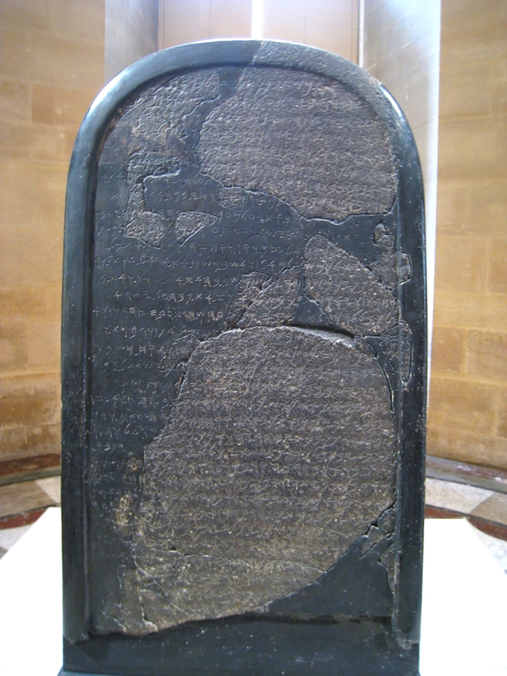
米沙石(摩押石)
1868年德國宣教士發現於底本(今
約但境內)。
高124寬71公分，今藏巴黎羅浮宫。
聖經人物的名字：暗利家、基抹、 耶和華等。
記述摩押如何在米沙帶領下脫離以 色列的統治。

Slide 5
王下3與米沙石的比較
摩押王米沙牧養許多羊，每年將十萬羊羔的毛和十萬公綿羊的毛給以色列王進貢。亞哈死後，摩押王背叛以色列王。那時約蘭王出撒瑪利亞，數點以色列眾人。… 摩押人到了以色列營，以色列人就起來攻打他們，以致他們在以色列人面前逃跑。以色列人往前追殺摩押人，直殺入摩押的境內…
I am Mesha, the son of Kemosh … Omri was king of Israel and oppressed Moab many days, for Chemosh was angry with his land. And his son succeeded him and he also said I will oppress Moab. … but I got the upper hand of him and his house: and Israel perished for ever... And Kemosh said to me, 'Go, take Nebo from Israel.‘ … from there I took the vessels of Yahweh, and I presented them before the face of Kemosh.

Slide 6
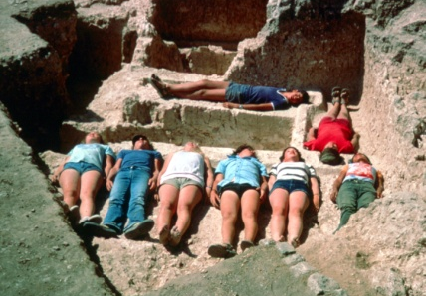
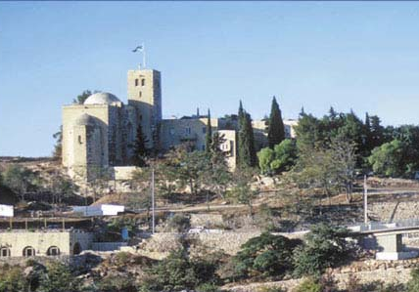
Ketef Hinnom

Slide 7
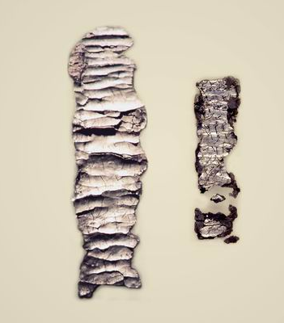
Ketef Hinnom Amulets

Slide 8
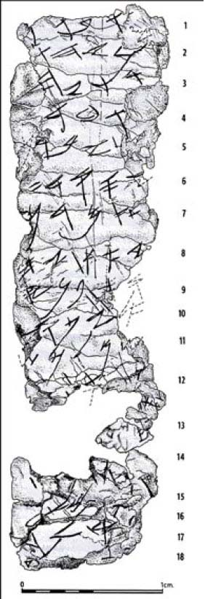
Ketef Hinnom Amulet #2
-h/hu. May be blessed h/sh-
-[e] by YHW[H,]
the warrior/helper and
the rebuker of
[E]vil: May bless you,
YHWH,
keep you.
Make shine, YH-
-[W]H, His face
[upon] you and g-
-rant you p-
-[ea]ce.

Slide 9
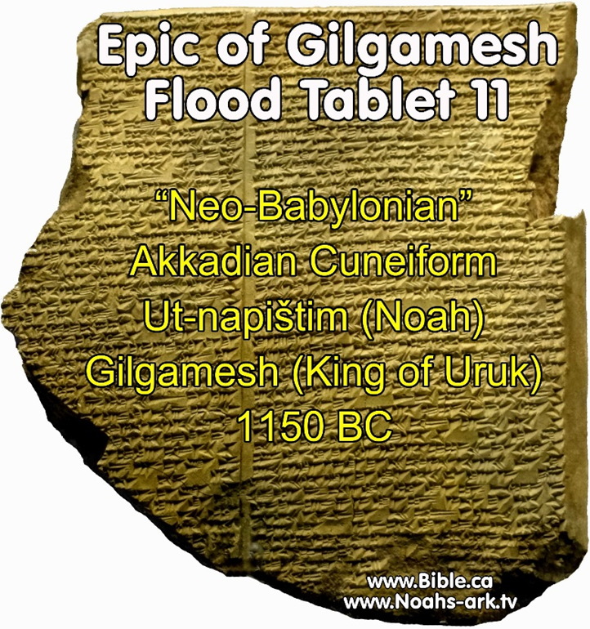
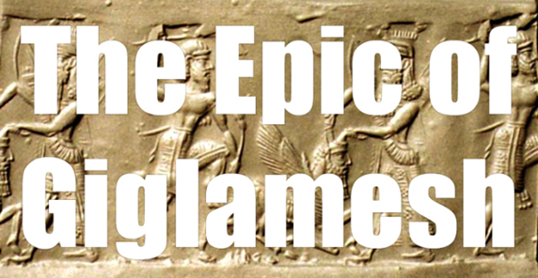

Slide 10
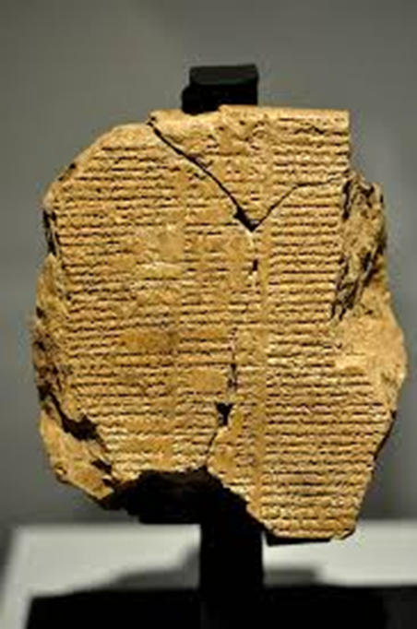
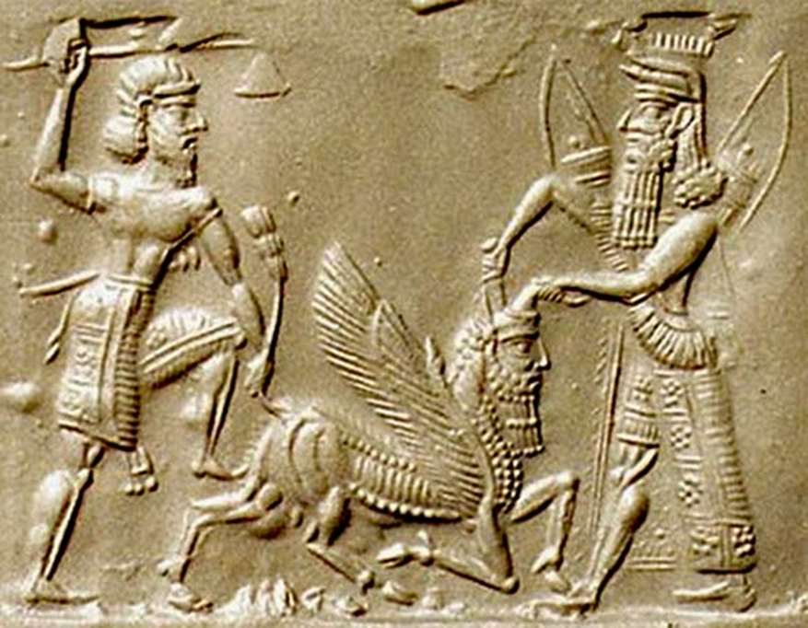

Slide 11
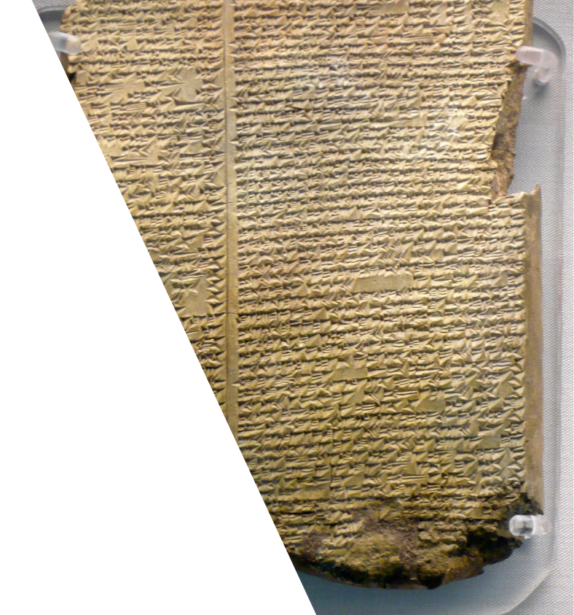
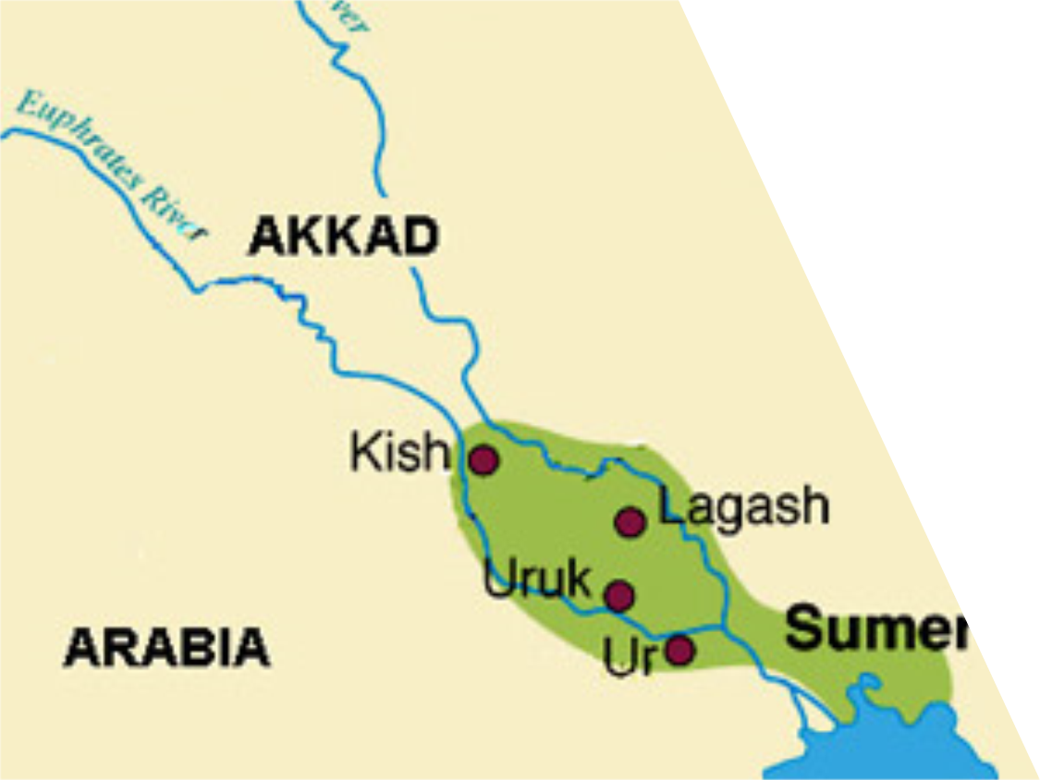

Slide 12
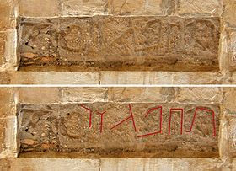
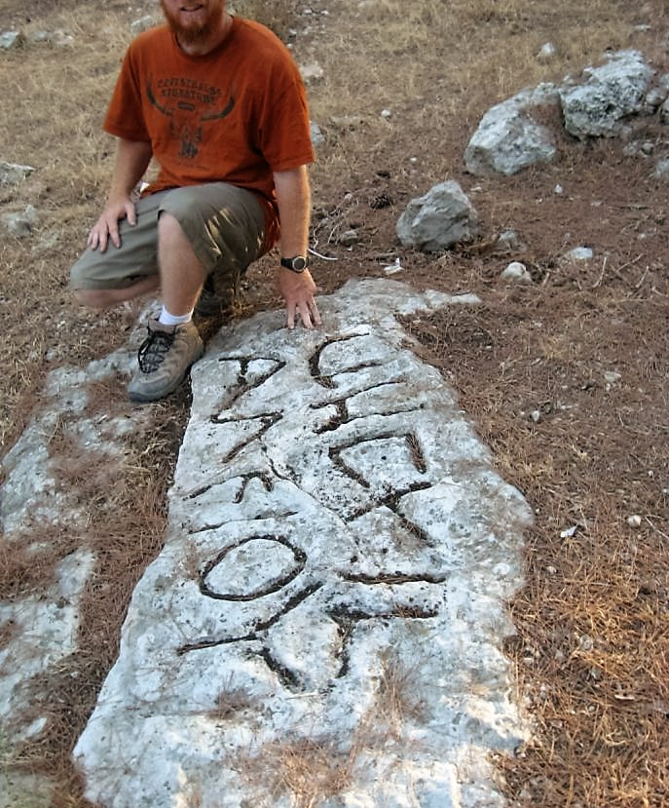
基色
界石
http://www.bpnews.net/37929/ancient-inscription-found-by-swbts-team

